Slide 1
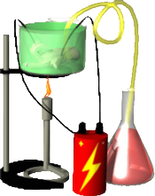
Notes: Creating the United States
“The Great Experiment”

Slide 2
Creating U.S. on Paper (important documents)
1776 Declaration of Independence
1781 Articles of Confederation go into effect
1783 Treaty of Paris ends Rev. War
1787 Constitutional Convention is held in Philadelphia
1788 U.S. Constitution is approved by all 13 states
1791 Bill of Rights is approved

Slide 3
Document Purpose
1.Declaration of Independence | Separate from England
2. Articles of Confederation | Quick plan for government during the war
3. Treaty of Paris | Ended the Revolutionary War
4. Constitutional Convention | Meeting of delegates to write a new plan for government
5. U.S. Constitution | The written plan for the U.S. government
6. Bill of Rights | Changes to Constitution to protect individual rights

Slide 4
Constitutional Convention
1787
Philadelphia
Meeting of Delegates from all 13 states
This meeting produced the U.S. Constitution

Slide 5
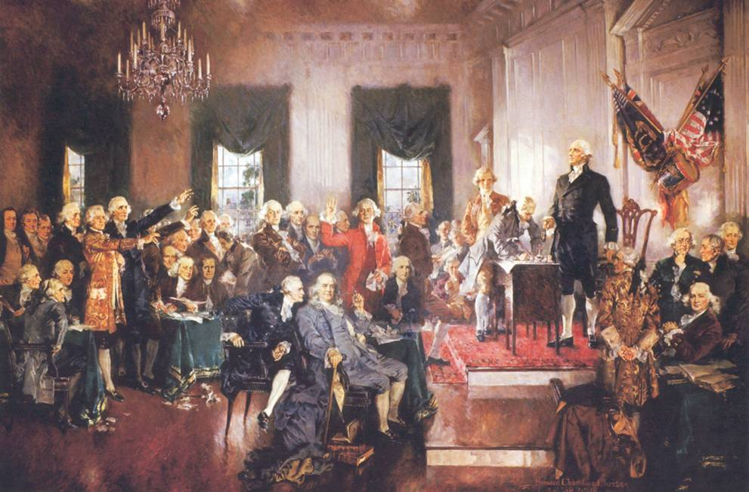
Constitutional Convention

Slide 6
The United States Constitution
A document written in 1787 to…
1. Provide a plan for the new U.S. government
2. Protect the rights of U.S. citizens
Was not ratified (approved) by all 13 states until 1788

Slide 7
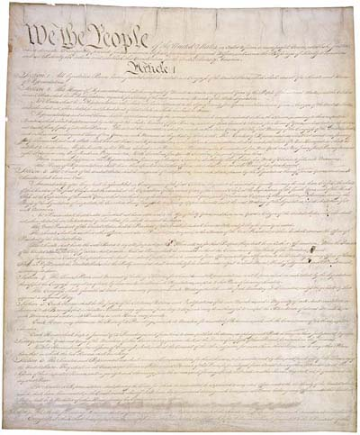
U.S. Constitution

Slide 8
U.S. Constitution
Precedent
Checks and Balances
Bill of Rights
Amendment
Federalism
Impeachment
Ratify
Congress
Constitution
Supreme Court

Slide 9
Federalism
A system of government in which power is shared between a big national government and smaller state governments
Writers of the Constitution did this because they feared a central government that was too powerful (like a king)

Slide 10
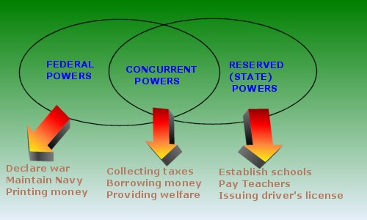
Federalism
NationalPowers
Shared Powers
State Powers

Slide 11
Separation of Powers
The powers and roles of the Government are divided into 3 different branches (parts)
1. Legislative (makes the laws)
2. Executive (carries out the laws)
3. Judicial (makes sure laws follow Constitution)
This was to prevent one group from getting too much power

Slide 12
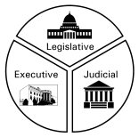
Separation of Powers

Slide 13
Checks and Balances
Each of the 3 branches of Government has some powers that can limit the powers of the other 2 branches
This was to make sure the 3 branches worked together fairly

Slide 14
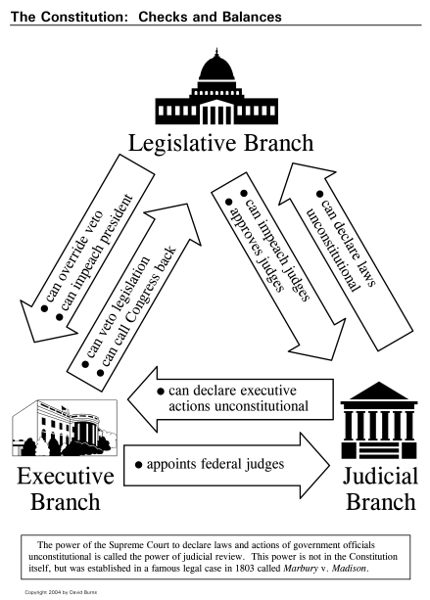
Checks and Balances

Slide 15
Limited Powers
The power of government is limited by its own laws
Even the President of the U.S. has to obey all of the laws
This is to make sure that the government cannot abuse its power

Slide 16
Bill of Rights
All U.S. citizens have certain rights that the government can never take away
These are listed in the Bill of Rights
Example (right to free speech, right to meet peacefully)

Slide 17
So, why was the Creation of the United States called the ‘Great Experiment?”
In 1787, most countries were controlled by a King or Queen
No one was sure what would happen when “The People” got to design and control their own government

Slide 18
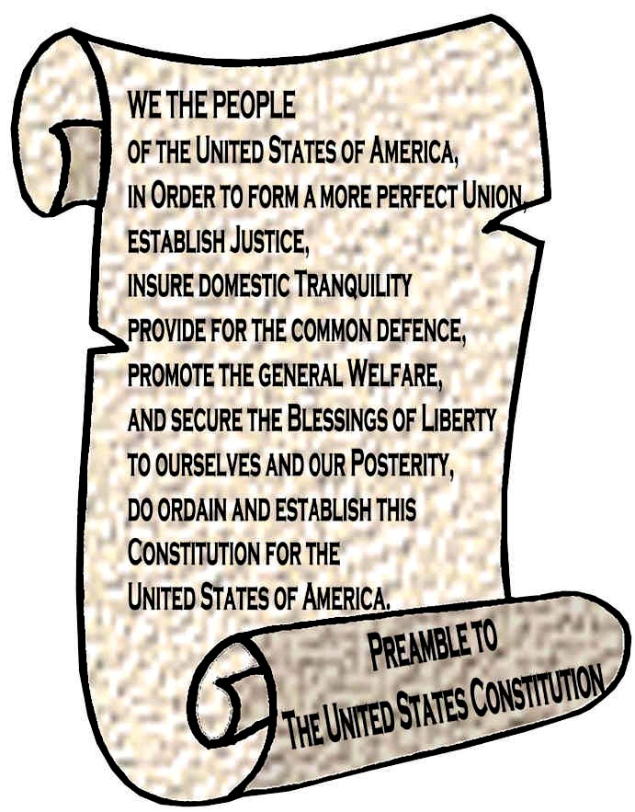
Preamble
The introduction to the Constitution that outlines the goals of the document.

Slide 19
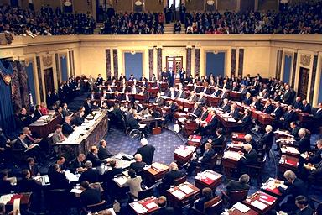
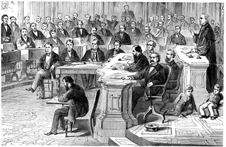
Impeachment
To accuse the President of wrong doing in his office and making the decision to put him on trial for that wrong doing.

Slide 20
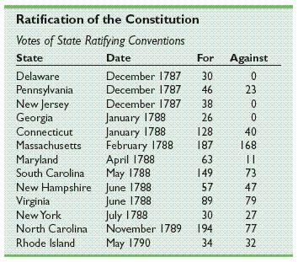
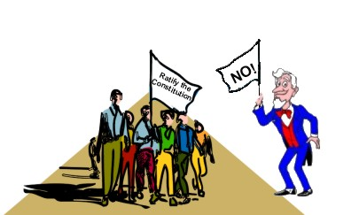
Ratification
To approve of something in order to make it official.

Slide 21
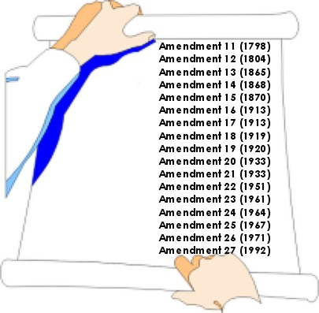
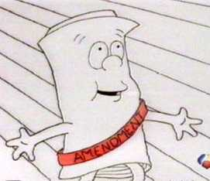
Amendment
A change to the something (i.e. the Constitution) that overrides (when needed) the previously stated rules.

Slide 22
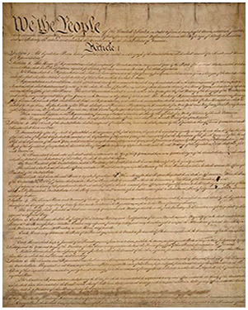
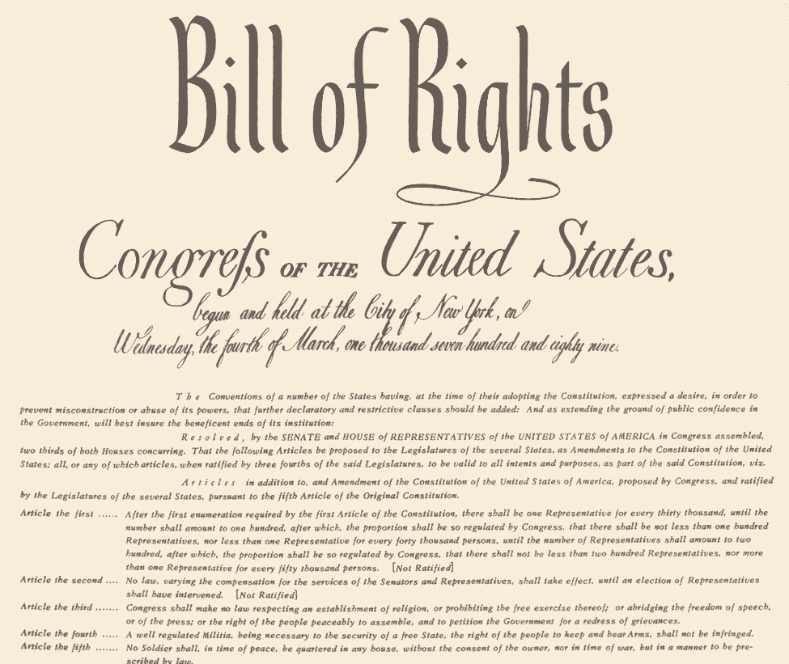
Precedent
The process by which something is done in a way that establishes how that thing will be done in the future by others.

